Slide 1
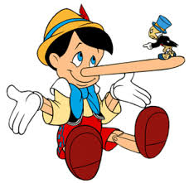
HONESTY
Always the best policy

Slide 2

HONESTY
Why is it so important to be honest?
Ultimate reason is because God requires it…
Is that important to us?
What does the bible say about it?

Slide 3
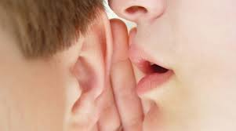
HONESTY
There are two commandments God gave about this:
1/ Exodus 20:16: You shall not bear false witness against your neighbor
What kind of things does this include?
Gossip, lying, generally being mean and unloving.

Slide 4
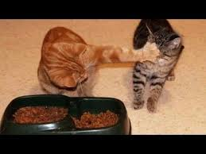


HONESTY
2/ Exodus 20:15: You shall not steal.
What kinds of things would this include?

Slide 5
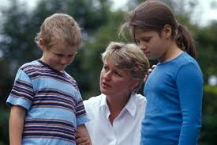
HONESTY
..Also when we have to say « Who did it »
What are some reasons we would do these things?
We are afraid of not being first or looking bad
Afraid of consequenes
Want what others have
We are selfish by nature

Slide 6
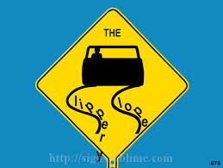
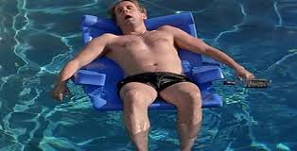
HONESTY
If God has made it so clear, why
do we still sin?
We have a natural tendancy to sin (Romans 3:23). We were born this way and only God can save us.
We don’t believe God and his promises
We love other things and ourselves more than God.

Slide 7

HONESTY
If we continue in dishonesty/lying, who are we serving?
John 8:44 « Satan is a liar and the father of lies »
- Jesus said we are ‘satan’s children’ if we follow his ways
Jesus said « I am the way, the truth and the life ». (John 14:6) If we would follow him, we need confess the truth. Jesus promised: « If we confess our sins, He will forgive us » (1 John 1:9)
Then we need to determine to live honestly for Him.

Slide 8
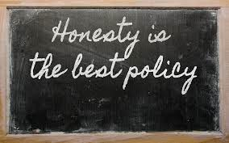
HONESTY
Developing the habit of honesty.
We can apply these principles:
Keep your promises and committments. Don’t promise to do something you are unable or unwilling to fulfill.
Accept responsibility. Take the blame when you are to blame.
Resolve that with God’s help you will be honest even if it hurts Because you live for God not yourself, and because:

Slide 9
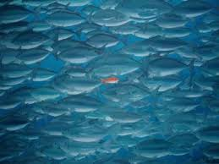
HONESTY
What is a big challenge to this?
It requires go against the flow of most of the world around us; where Honesty is not chrished as it should be.
We can be afraid of what others think of us, but we should be more afraid of what God thinks. (Matthew 10:28)

Slide 10
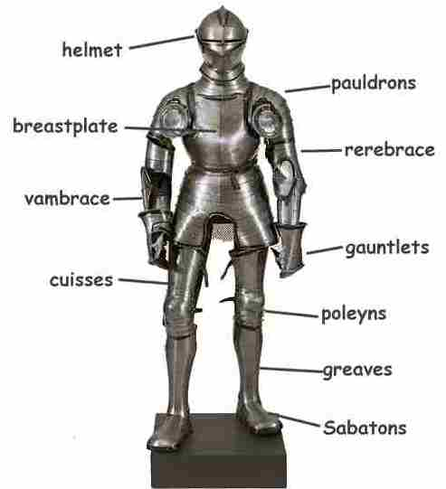
HONESTY
Of course, learning these principles
is part of what makes us a:
« KNIGHT IN TRAINING »
Some further scriptures:
Ephesians 4:25; 28-29.
Proverbs 12:17
Proverbs 24:26
Remember: God is love, and all His ways are loving. Dishonesty and lying are not loving…

